Slide 1
Ansible Automation in Azure

Slide 2
Why Ansible?
Automation Orchestrator
Easy to learn and read (YAML)
Open source, Python-based
Agentless (SSH and WinRM)

Slide 3
Agenda
Create basic infrastructure (Resource Group, Networking)
Create a Linux VM
Create an NSG and allow web traffic
Gather facts about the public and private IP addresses
Use those facts to populate a config template
Install software on the VM

Slide 4
Playbooks
https://github.com/davidnite/AnsibleDemo
0-prereq.yml Create Resource Group, vNet, Public IP
1-vmdeploy.yml Create Nic, Virtual Machine, NSG
2-appinstall.yml Gather facts, Render config template, Install software
Use deploy.sh to launch playbooks in order

Slide 5
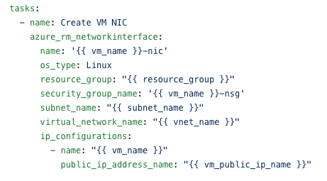
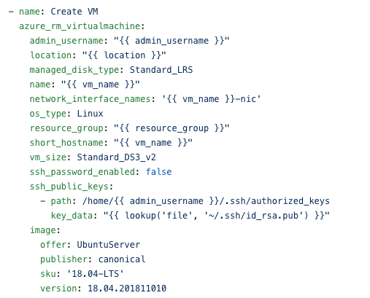
Deploying Infrastructure
Azure infrastructure can be deployed from a single playbook:
72 modules for deploying and configuring Azure Infrastructure
Support for ad-hoc ARM templates
Modules are idempotent (ad-hoc deployments may not be)
Support for dynamic inventory using python (azurerm.py)

Slide 6
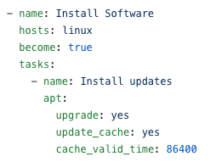
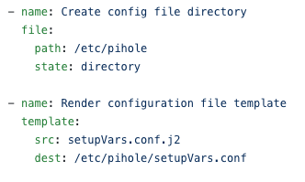
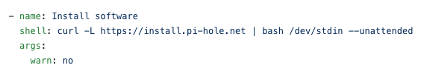
Configuration Management
Sample server configuration:
Deploy server configuration and applications
Check and Diff modes for previewing changes
Over 1,300 modules in core distribution
4,000+ modules in Ansible Galaxy

Slide 7
More Information
Ansible Documentation:
Ansible Installation Guide https://docs.ansible.com/ansible/latest/installation_guide/intro_installation.html
Ansible Module Index https://docs.ansible.com/ansible/latest/modules/modules_by_category.html#module-index
Ansible Azure cloud modules https://docs.ansible.com/ansible/latest/modules/list_of_cloud_modules.html#azure
Ansible and Azure:
Quickstart: https://www.ansible.com/integrations/cloud/microsoft-azure
Dynamic Inventory: https://docs.microsoft.com/en-us/azure/ansible/ansible-manage-azure-dynamic-inventories

